Slide 1

LiDAR in Remote Sensing: From Traditional Methods to Deep Learning
(A brief intro)
Dr. Fei Zhang
04/22/2025

Slide 2
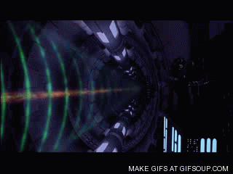
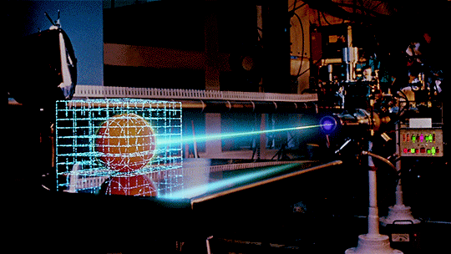
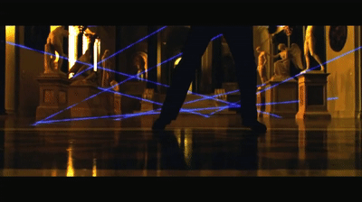
Quiz
1. Which of the following movie scenes best resembles how real LiDAR technology works today (in 2025)?
Rogue One: A Star Wars Story (2016) https://www.google.com/url?sa=i&url=https%3A%2F%2Fimgur.com%2Fgallery%2Fhopes-class-4-5-beam-laser-5Eew4mn&psig=AOvVaw0-xvKURfgtF4XW6WxwtLC3&ust=1745346703064000&source=images&cd=vfe&opi=89978449&ved=0CBQQjhxqFwoTCJDFlbbl6YwDFQAAAAAdAAAAABAE
B. Tron (1982)
https://www.google.com/url?sa=i&url=https%3A%2F%2Fsci-fi-gifs.tumblr.com%2Fpost%2F768995527999242240&psig=AOvVaw0-xvKURfgtF4XW6WxwtLC3&ust=1745346703064000&source=images&cd=vfe&opi=89978449&ved=0CBQQjhxqFwoTCJDFlbbl6YwDFQAAAAAdAAAAABAJ
C. Ocean's Twelve (2004) https://www.google.com/url?sa=i&url=https%3A%2F%2Fmakeagif.com%2Fgif%2Foceans-twelve-laser-dance-hd-1080p-S62pot&psig=AOvVaw1pECVATbn8HYooQs8tgUll&ust=1745347449767000&source=images&cd=vfe&opi=89978449&ved=0CBQQjhxqGAoTCMCAk4jk6YwDFQAAAAAdAAAAABDpAQ
Notes:
A. a space weapon
B. a 3D scan device
C. a security system.

Slide 3
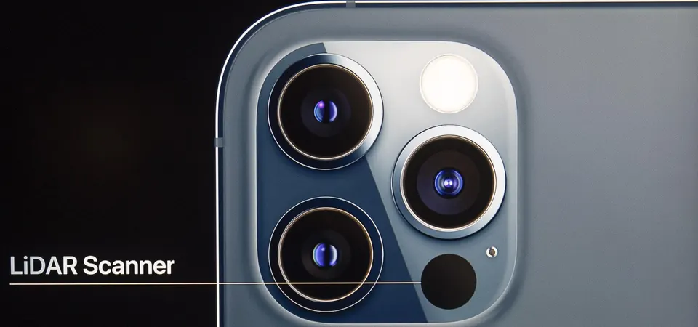
Quiz
2. What does the LiDAR on an iPhone 12 Pro do?
Faster and sharper photos in low light
Room scanning and measurements
Augmented Reality (AR)
Notes:
A. It improves focus and portrait effects in night mode by understanding depth better.
B. Apps like Measure or IKEA Place use LiDAR to accurately measure spaces and objects.
C. AR apps (like those from IKEA, Snapchat, or games) can anchor virtual objects more realistically in your environment.

Slide 4
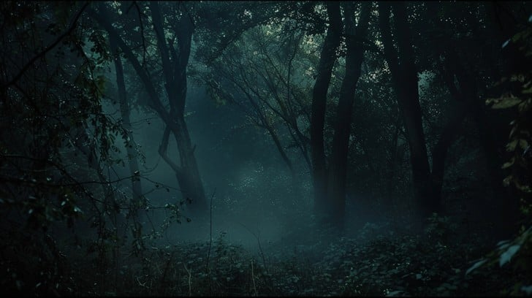


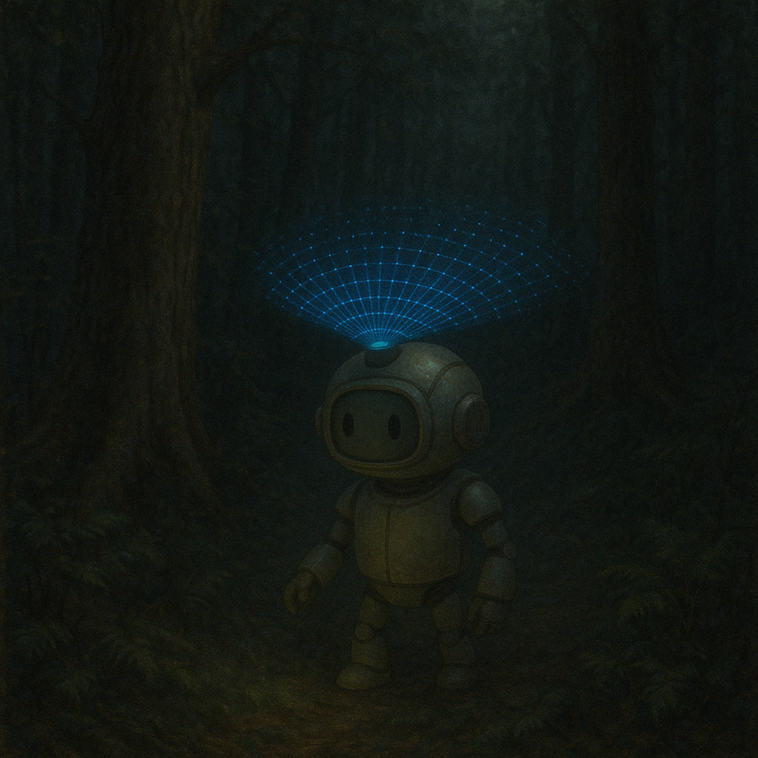
Quiz
3. If you were building a robot to explore a dense, dark forest, which tool would help it "see" and safely find its way through?
A flashlight and a stick
B. A 2D camera with night vision
C. A LiDAR scanner
Notes:
A flashlight and a stick - to poke around and light the way, one step at a time
A 2D camera with night vision – to take flat images, even in low light
A LiDAR scanner – to scan the surroundings and build a 3D map in real time

Slide 5
Outline
1. Introduction to LiDAR and Remote Sensing
2. Traditional Point Cloud Techniques
1. Noise Filtering - SOR vs ROR
2. Ground Filtering - Cloth Simulation Filter
2. Feature Extraction & Structural Analysis
3. Classification and Segmentation (non-DL)
4. Point Cloud Registration - ICP
3. Deep Learning for LiDAR
1. Motivation: Why DL?
2. Historical Context
3. PointNet
4. Practical Considerations
4. Explainability in DL
5. Summary & Future Directions + Quick Q&A

Slide 6
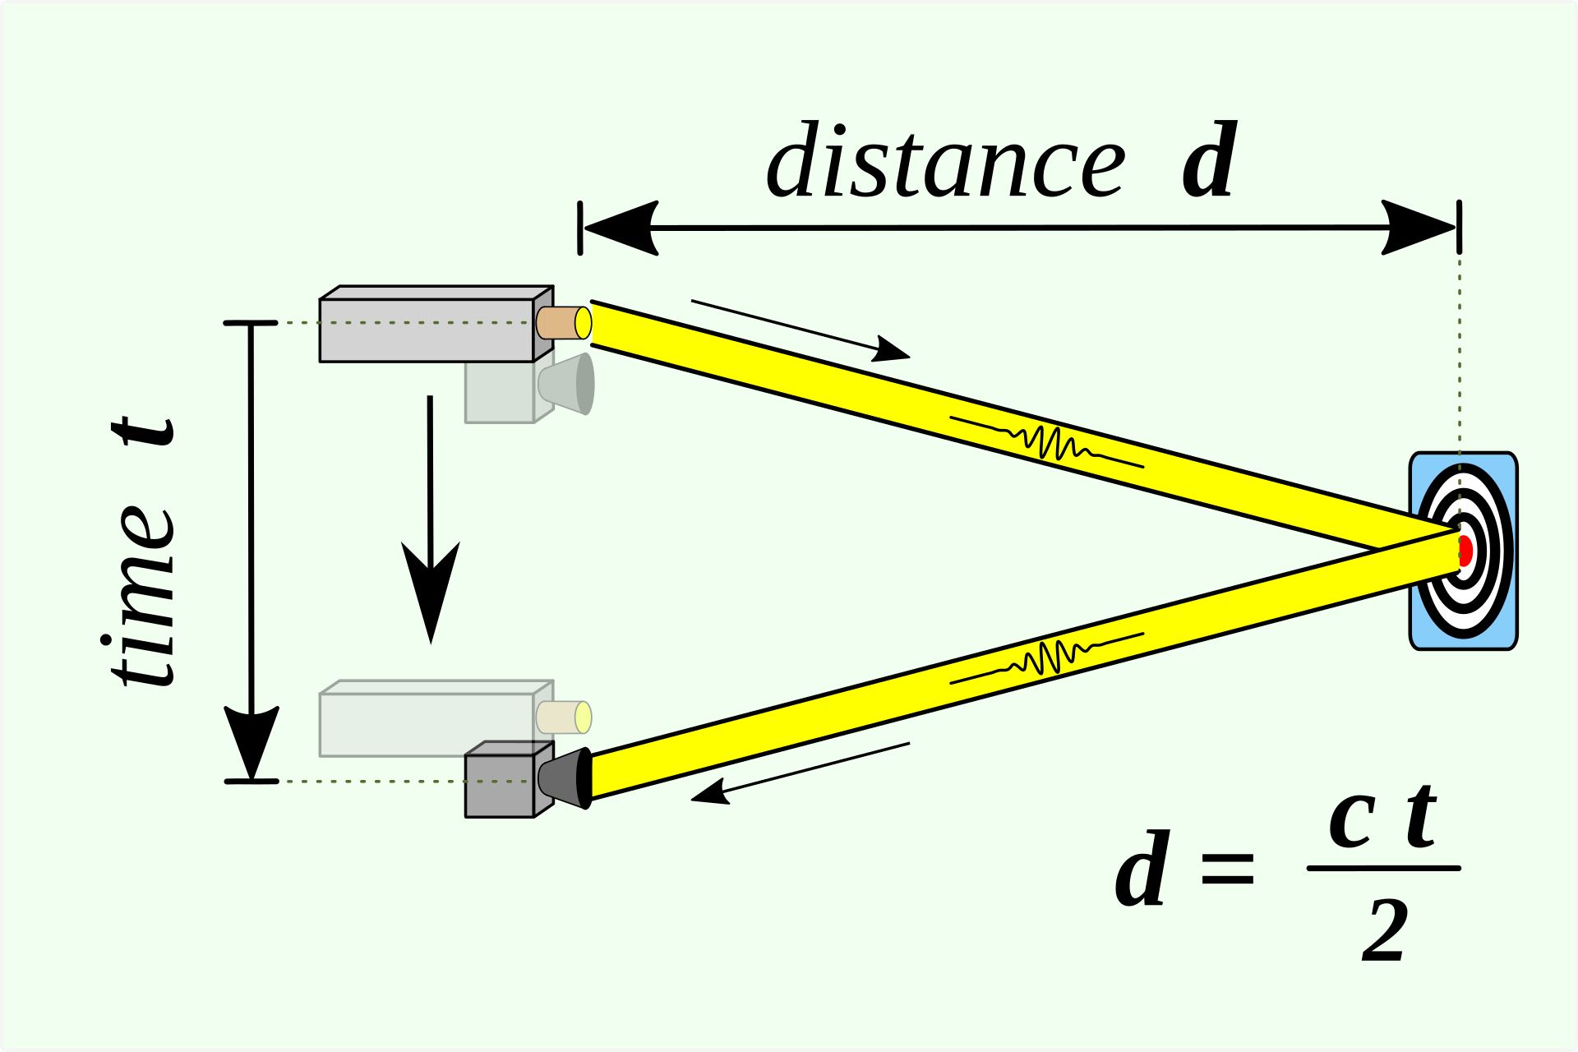
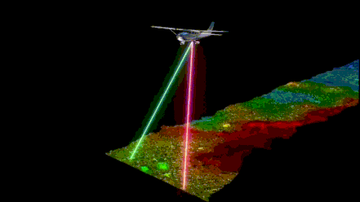
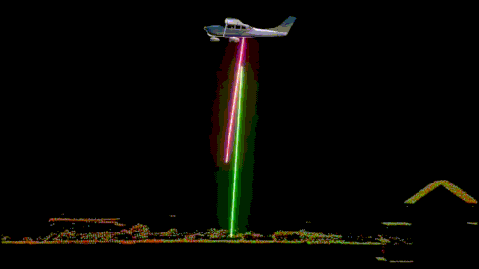
What is LiDAR
An example of airborne LiDAR ref:https://www.geoilenergy.com/en/servicios/geoespaciales/eagle-mapping

Slide 7

What is LiDAR
Why lasers?
ref: https://www.laserscanningforum.com/forum/viewtopic.php?t=17157
Notes:
Why lasers? Why not just a normal lights, like LEDs, or flashlights?
highly coherent vs incoherent
very directional vs spread out
single wavelength vs wide range of wls

Slide 8
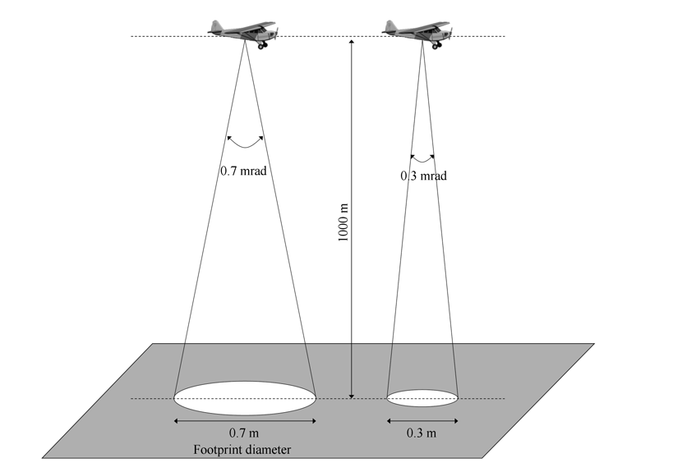
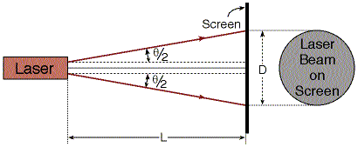
Laser Beam Divergence
ref: https://web.phys.ksu.edu/VQM/laserweb/Labs/Diverge/Cdiverge2.htm
ref: Lidar beam divergence and footprint – Geohub
https://www.google.com/url?sa=i&url=https%3A%2F%2Fgeohubkenya.wordpress.com%2F2019%2F05%2F17%2Flidar-beam-divergence-and-footprint%2F&psig=AOvVaw2B8qdWc1i0c_nJwgIwaAsx&ust=1745336595315000&source=images&cd=vfe&opi=89978449&ved=0CBcQjhxqGAoTCJiZudC76YwDFQAAAAAdAAAAABCZAQ

Slide 9
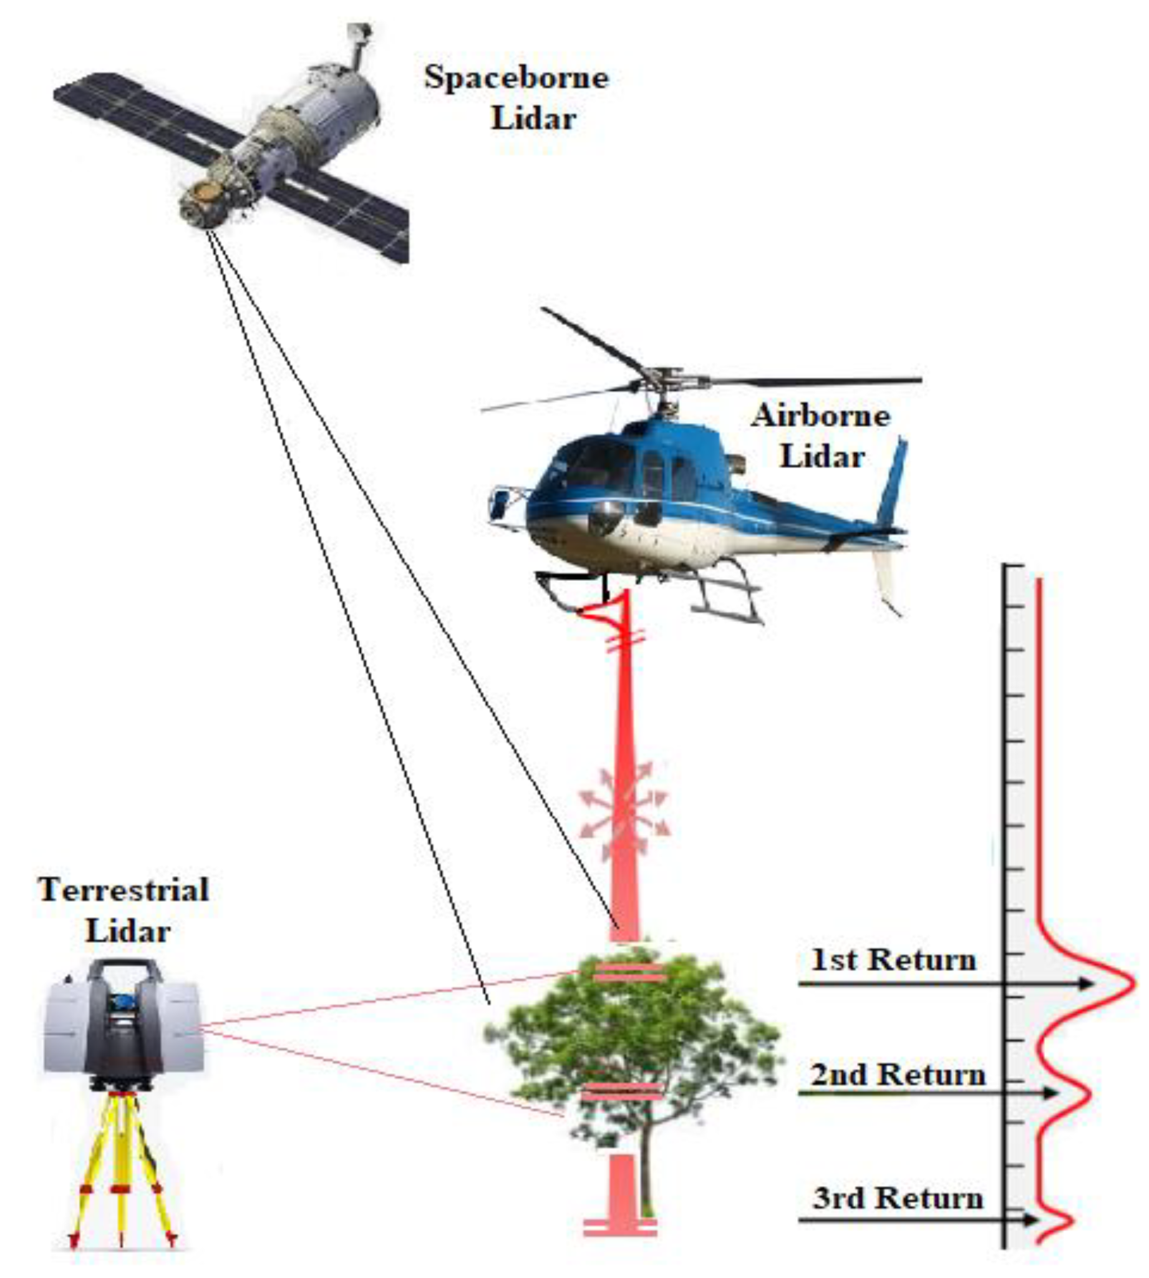
LiDAR on different platforms
Why multiple returns?
Illustration of the various remote sensing platforms for forest structure measurements. Borsah, A. A., Nazeer, M., & Wong, M. S. (2023). LIDAR-Based Forest Biomass Remote Sensing: A Review of Metrics, Methods, and Assessment Criteria for the Selection of Allometric Equations. Forests, 14(10), 2095. https://doi.org/10.3390/f14102095

Slide 10
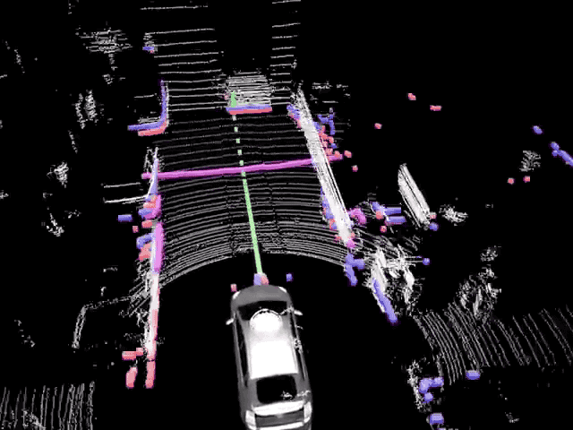
LiDAR on Autonomous Vehicles
An example LiDAR point cloud on Self-Driving Cars. https://www.google.com/url?sa=i&url=https%3A%2F%2Fmedium.com%2F%40BabakShah%2Flidar-in-self-driving-cars-cee29db94af7&psig=AOvVaw2LzjL5ysaiZHlerfRnxv_B&ust=1745345894988000&source=images&cd=vfe&opi=89978449&ved=0CBQQjhxqFwoTCJiYo6be6YwDFQAAAAAdAAAAABA5

Slide 11
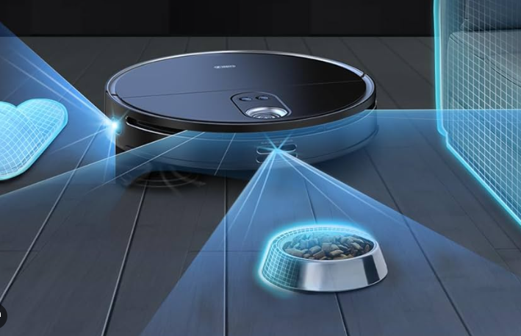
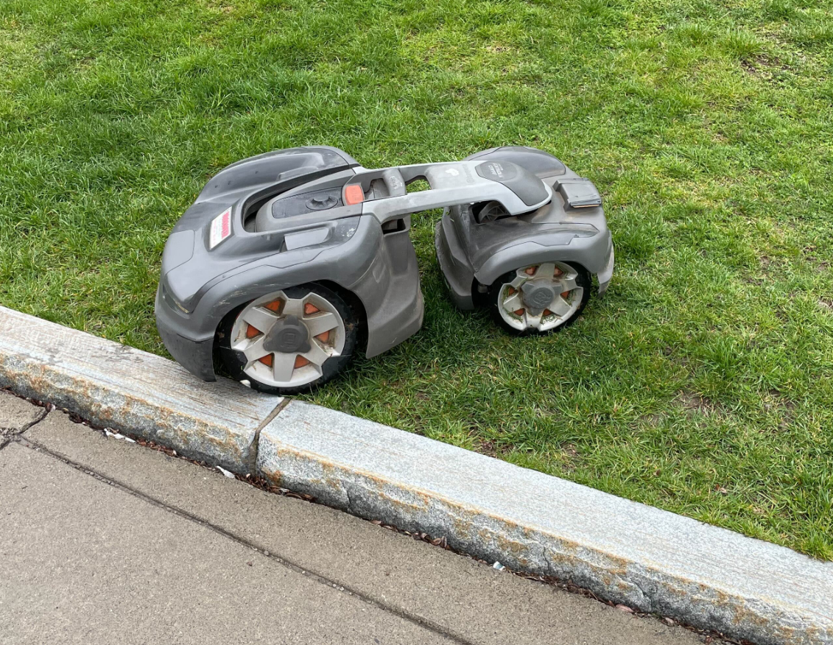
Why LiDAR - applications
Autonomous vehicles (cars, delivery bots)
Drone mapping (precision agriculture, inspection)
Forestry terrain & canopy structure
Warehouse robots (AMRs, AGVs)
Construction site monitoring
3D modeling of indoor spaces (real estate)
…
Anymore?
Notes:
robot vacuum
robot mower

Slide 12
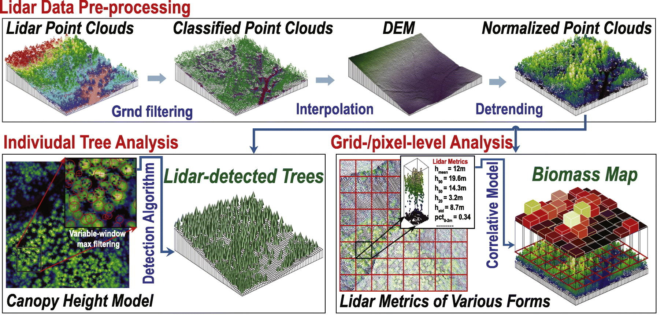
LiDAR in Forestry
A typical workflow to derive forest information.

Slide 13
Traditional Point Cloud Techniques
Preprocessing and filtering
SOR
ROR
Ground filtering - CSF

Slide 14
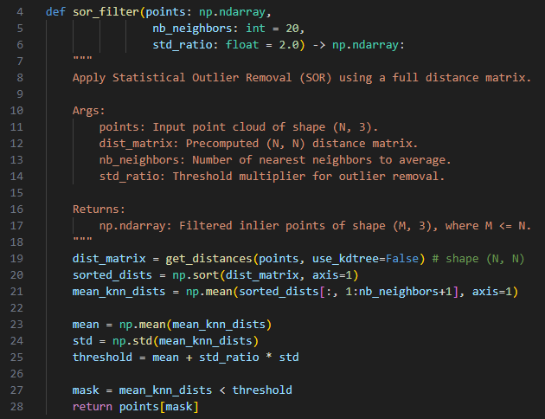
Statistical Outlier Removal (SOR)
Principle:
SOR identifies noisy points based on statistical analysis of the distances between each point and its neighbors.
Steps:
Define a neighborhood: For each point, find its k nearest neighbors (typically k=20–50).
Calculate the mean distance: Compute the mean distance from this point to its neighbors.
Identify outliers: Points whose mean distances exceed a threshold (typically defined as a mean distance plus a multiple of standard deviations) are considered outliers and are removed.
Typical Parameters:
Number of Neighbors (k): Determines the neighborhood size.
Standard Deviation Multiplier (std): Points with mean distances greater than mean + std × σ are removed.
How to calculate the distance_matrix?

Slide 15
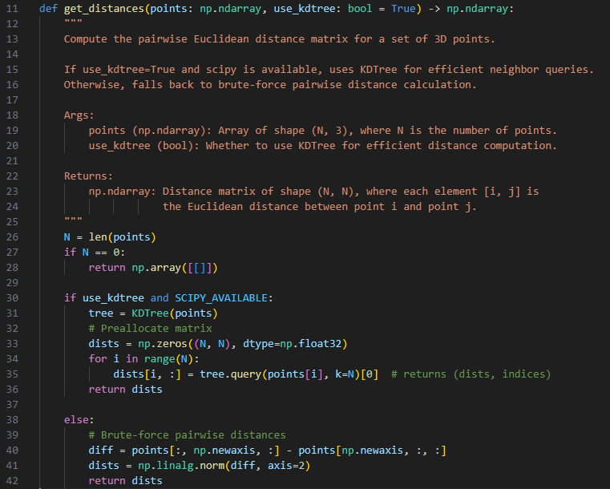
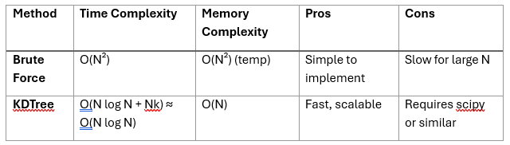
Statistical Outlier Removal (SOR)
Principle:
SOR identifies noisy points based on statistical analysis of the distances between each point and its neighbors.
Steps:
Define a neighborhood: For each point, find its k nearest neighbors (typically k=20–50).
Calculate the mean distance: Compute the mean distance from this point to its neighbors.
Identify outliers: Points whose mean distances exceed a threshold (typically defined as a mean distance plus a multiple of standard deviations) are considered outliers and are removed.
Typical Parameters:
Number of Neighbors (k): Determines the neighborhood size.
Standard Deviation Multiplier (std): Points with mean distances greater than mean + std × σ are removed.

Slide 16
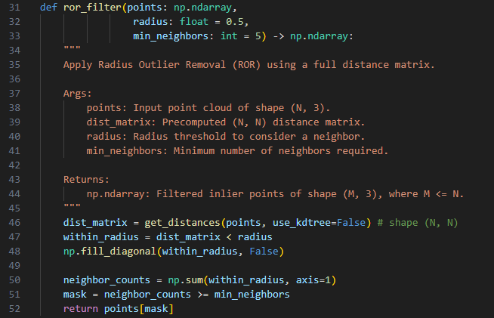
Radius Outlier Removal (ROR)
Principle:
ROR removes points based on the number of neighboring points within a fixed radius.
Steps:
Define a radius (r): Choose a spherical neighborhood radius around each point.
Count neighbors: For each point, count how many neighbors fall within this radius.
Identify outliers: If the number of neighbors within the radius is below a specified threshold, the point is considered an outlier and removed.
Typical Parameters:
Radius (r): Defines the neighborhood search radius.
Minimum Neighbor Count: Minimum number of neighbors required to keep a point.

Slide 17
SOR vs ROR
Feature | SOR | ROR
Neighborhood Definition | k-nearest neighbors | Fixed radius neighbors
Outlier Criterion | Mean distance + std deviation | Neighbor count within radius
Density Adaptivity | Good for variable densities | Less adaptive; better for uniform densities
Parameter Sensitivity | Moderate | High
Computational Cost | Moderate (fast with k-d trees) | Moderate to High (depends on radius and density)
Notes:
Practical Recommendations:
Use SOR when dealing with variable point cloud densities or unknown density distributions.
Use ROR when point cloud density is relatively uniform or you clearly understand your data's spatial distribution.
Both filters are commonly available in libraries such as PCL (Point Cloud Library) and Open3D.

Slide 18
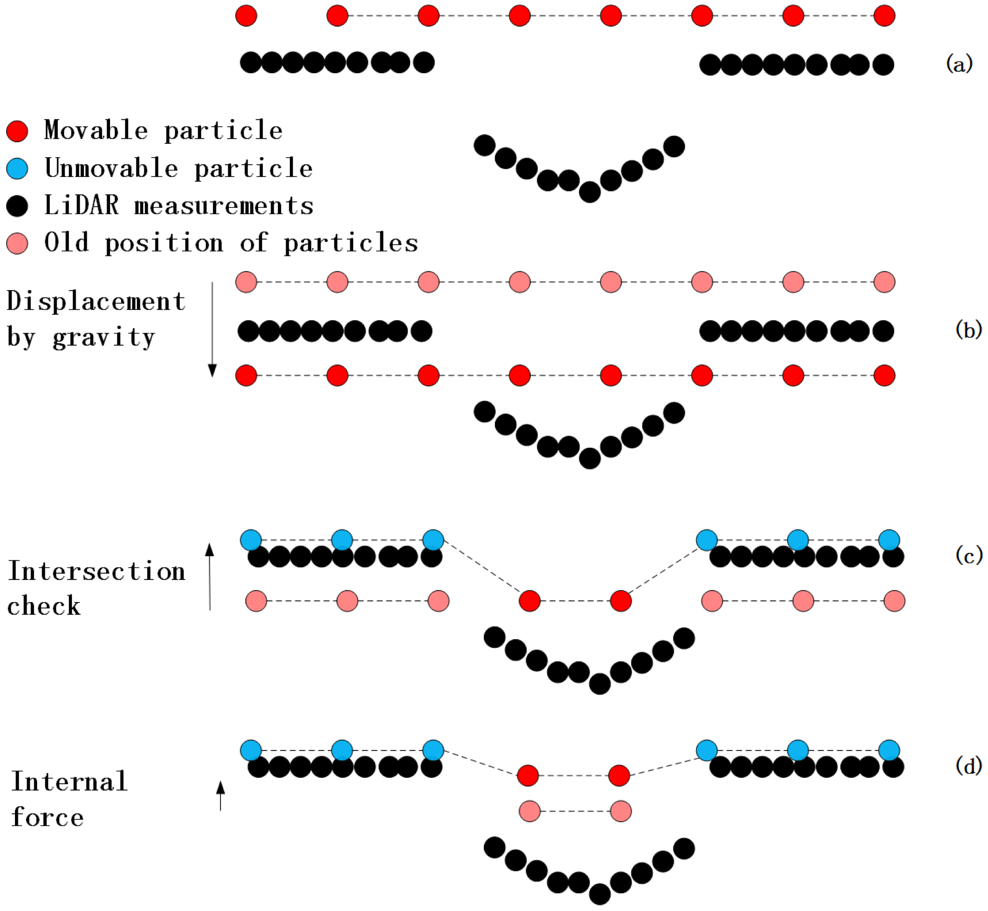
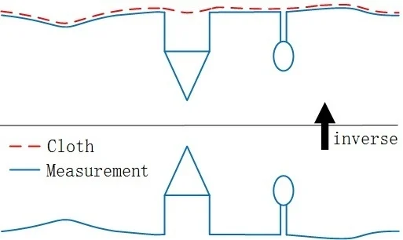
Preprocessing and filtering
Ground filtering - Cloth Simulation Filter
Main Steps in CSF: (a) Initial state. A cloth is place above the inverted LiDAR measurements; (b) The displacement of each particle is calculated under the influence of gravity. Thus, some particles may appear under the ground measurements; (c) Intersection check. For those who are under the ground, they are moved on the ground and set as unmovable; (d) Considering internal forces. The movable particles are moved according to forces produced by neighbour particles.
Overview of the cloth simulation algorithm.
Zhang, W., Qi, J., Wan, P., Wang, H., Xie, D., Wang, X., & Yan, G. (2016). An Easy-to-Use Airborne LiDAR Data Filtering Method Based on Cloth Simulation. Remote Sensing, 8(6), 501. https://doi.org/10.3390/rs8060501

Slide 19
PCA for normals and others
My previous slides.

Slide 20
Deep Learning for LiDAR

Slide 21
Motivation: Why Deep Learning?
Superior Performance on Complex Tasks
Automatic feature learning (vs hand-crafted)
End‑to‑End Training and Task Specialization
no more parameters tuning once the model is built.

Slide 22
Early DL Methods on Point Clouds
Initial attempts: Voxel-based methods (~2015)
Multi-view methods (~2016)
Emergence of point-based methods (~2017-present)

Slide 23
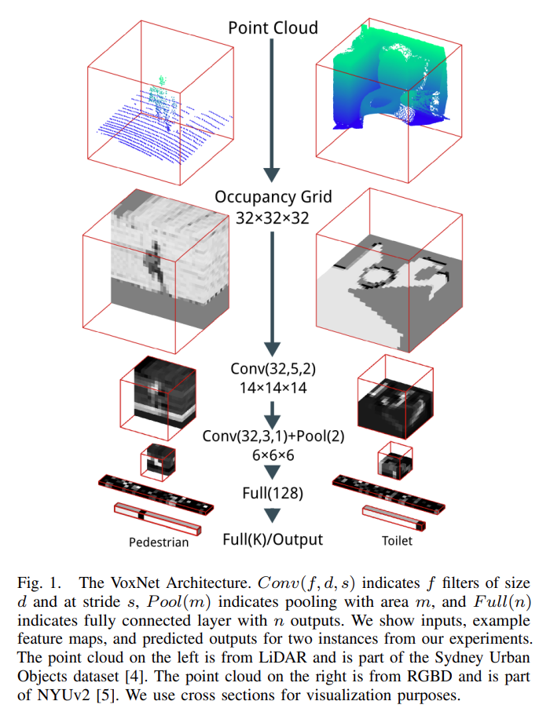
Early DL Methods on Point Clouds: Historical Context
Initial attempts: Voxel-based methods (~2015)
Maturana, D., & Scherer, S. (2015, September). Voxnet: A 3d convolutional neural network for real-time object recognition. In 2015 IEEE/RSJ international conference on intelligent robots and systems (IROS) (pp. 922-928). IEEE. Citation: 4449 (as of 04/19/2025)

Slide 24
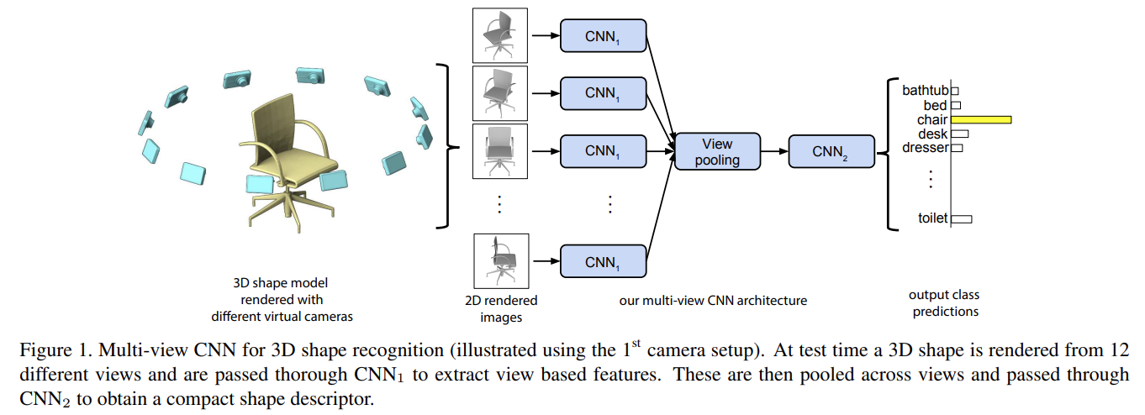
Early DL Methods on Point Clouds
Multi-view methods (~2016)
Projecting point clouds to multiple 2D views (MVCNN)
Advantages (leveraging mature CNN architectures)
Limitations (loss of geometric detail, computational inefficiency)
Su, H., Maji, S., Kalogerakis, E., & Learned-Miller, E. (2015). Multi-view convolutional neural networks for 3d shape recognition. In Proceedings of the IEEE international conference on computer vision (pp. 945-953). Citations: 4412 as of 04/19/2025

Slide 25
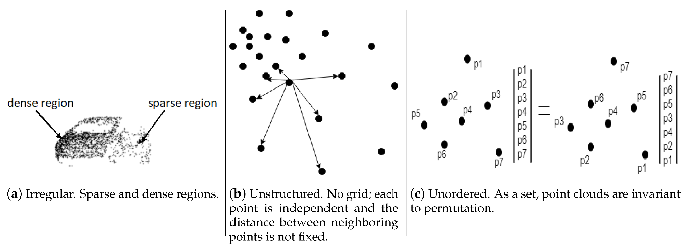
Challenges for direct point-based learning
Bello, S. A., Yu, S., Wang, C., Adam, J. M., & Li, J. (2020). Review: Deep Learning on 3D Point Clouds. Remote Sensing, 12(11), 1729. https://doi.org/10.3390/rs12111729

Slide 26
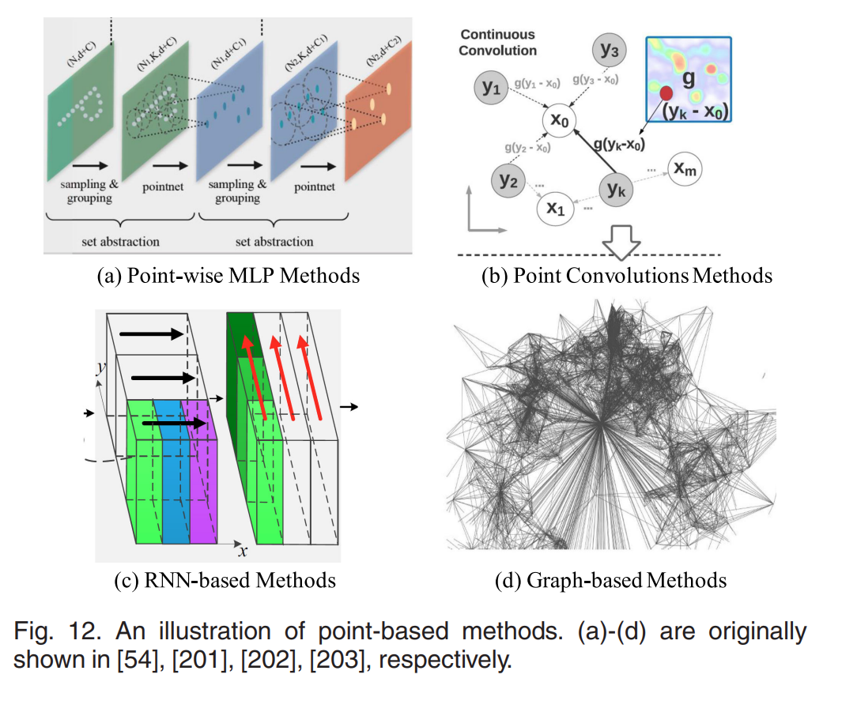
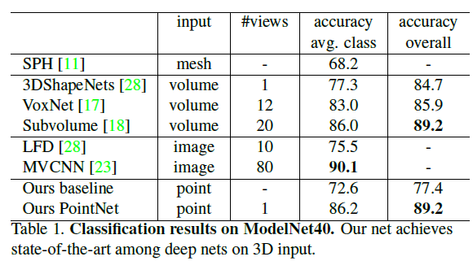
Early DL Methods on Point Clouds
Emergence of point-based methods (~2017-present)
Qi, C. R., Su, H., Mo, K., & Guibas, L. J. (2017). Pointnet: Deep learning on point sets for 3d classification and segmentation. In Proceedings of the IEEE conference on computer vision and pattern recognition (pp. 652-660).
Cited by 19544

Slide 27
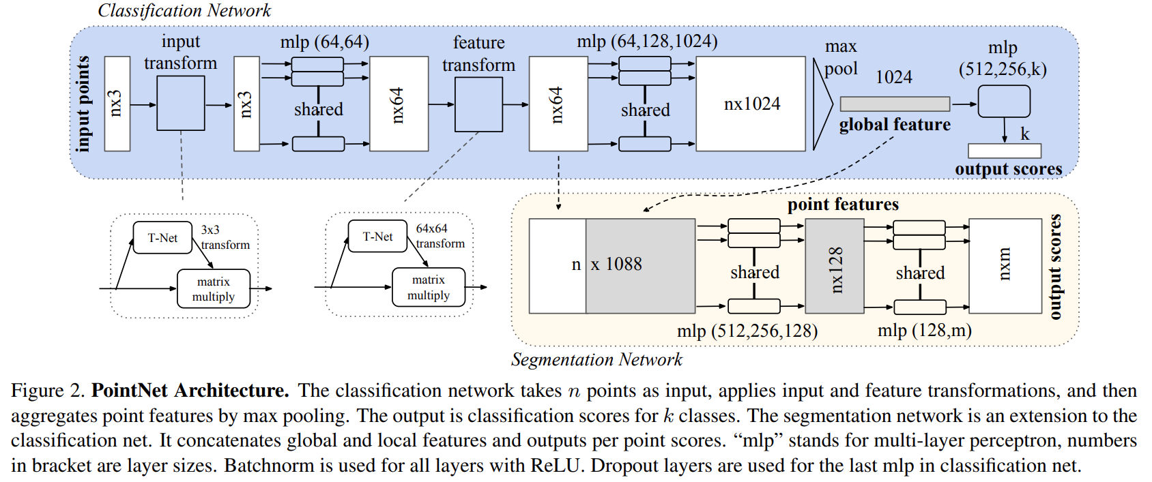
Pointnet
Emergence of point-based methods (~2017-present)
Qi, C. R., Su, H., Mo, K., & Guibas, L. J. (2017). Pointnet: Deep learning on point sets for 3d classification and segmentation. In Proceedings of the IEEE conference on computer vision and pattern recognition (pp. 652-660).
Cited by 19544
Notes:
t an affine transformation matrix by a mini-network (T-net) The first transformation network is a mini-PointNet that
takes raw point cloud as input and regresses to a 3 3
matrix. It’s composed of a shared MLP(64; 128; 1024)
network (with layer output sizes 64, 128, 1024) on each
point, a max pooling across points and two fully connected
layers with output sizes 512, 256. The output matrix is
initialized as an identity matrix. All layers, except the last
one, include ReLU and batch normalization.

Slide 28
Deep Dive into PointNet - Affine transformation matrix
affine-transformation-mathworks
Notes:
t an affine transformation matrix by a mini-network (T-net)

Slide 29
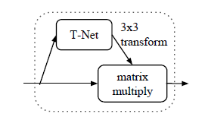
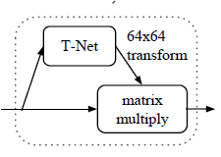
Deep Dive into PointNet - T-Net
Emergence of point-based methods (~2017-present)
Qi, C. R., Su, H., Mo, K., & Guibas, L. J. (2017). Pointnet: Deep learning on point sets for 3d classification and segmentation. In Proceedings of the IEEE conference on computer vision and pattern recognition (pp. 652-660).
Cited by 19544
Notes:
Why is T-Net?

Slide 30
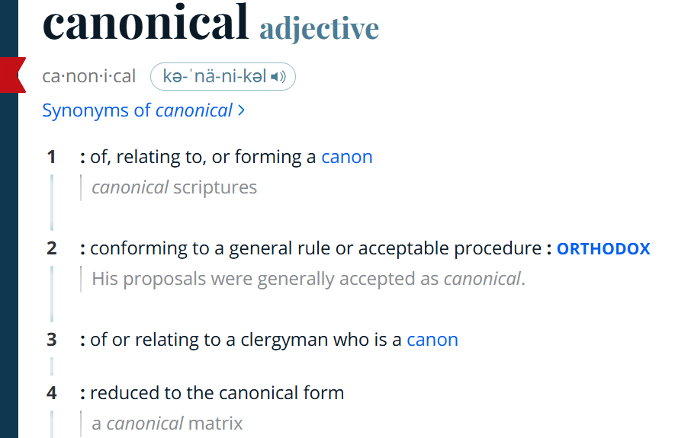
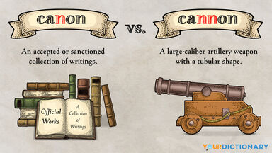
Canonicalization - How PointNet Learns Transformations
“canonicalize the data”
“sort input into a canonical order”
“align all input set to a canonical space”
Notes:
Canonicalization - To canonicalize something means to transform it into a standard, consistent, or normalized form — so that it's easier to process, compare, or analyze.
Think of it as saying:
“No matter how the input is rotated, flipped, or scaled, let’s rearrange it to a standard version, so we can recognize it.”

Slide 31
Canonicalization - How PointNet Learns Transformations
The first transformation network is a mini-PointNet designed to process raw point clouds.
Its goal is to regress to a 3×3 transformation matrix.
Architecture components:
Shared MLP layers on each point with output sizes: 64 → 128 → 1024.
Max pooling is applied across all points.
Followed by two fully connected layers with output sizes: 512 → 256.
The output is a 3×3 matrix, initialized as the identity matrix.
All layers except the last use ReLU activation and batch normalization.
Emergence of point-based methods (~2017-present)
Qi, C. R., Su, H., Mo, K., & Guibas, L. J. (2017). Pointnet: Deep learning on point sets for 3d classification and segmentation. In Proceedings of the IEEE conference on computer vision and pattern recognition (pp. 652-660).
Cited by 19544
Notes:
But wait, why 3x3? not 4x4? This is a linear transformation:
Includes rotation
scaling
shearing
possibly reflection
But it does not include translation.

Slide 32
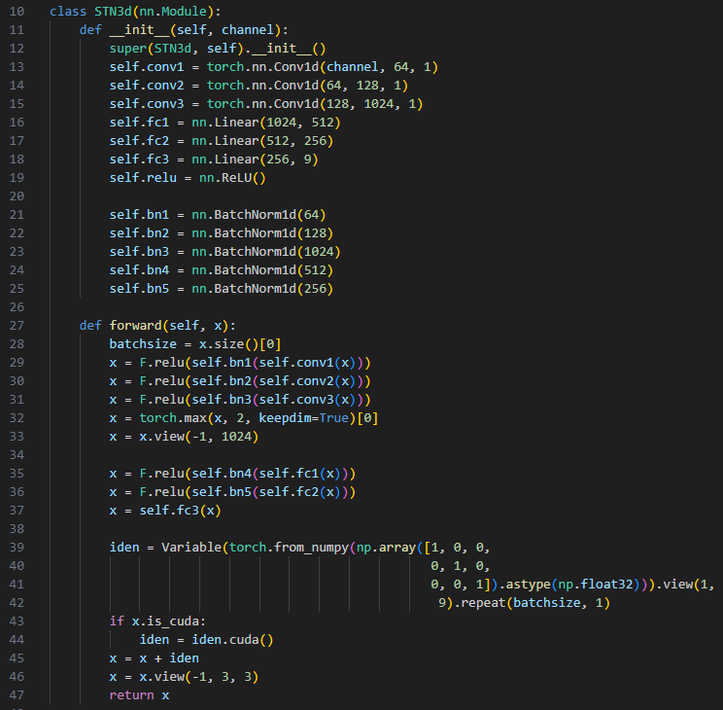
Canonicalization - How PointNet Learns Transformations
The first transformation network is a mini-PointNet designed to process raw point clouds.
Its goal is to regress to a 3×3 transformation matrix.
Architecture components:
Shared MLP layers on each point with output sizes: 64 → 128 → 1024.
Max pooling is applied across all points.
Followed by two fully connected layers with output sizes: 512 → 256.
The output is a 3×3 matrix, initialized as the identity matrix.
All layers except the last use ReLU activation and batch normalization.
https://github.com/yanx27/Pointnet_Pointnet2_pytorch
Qi, C. R., Su, H., Mo, K., & Guibas, L. J. (2017). Pointnet: Deep learning on point sets for 3d classification and segmentation. In Proceedings of the IEEE conference on computer vision and pattern recognition (pp. 652-660). Cited by 19544
Notes:
But wait, why 3x3? not 4x4? This is a linear transformation:
Includes rotation
scaling
shearing
possibly reflection
But it does not include translation.

Slide 33
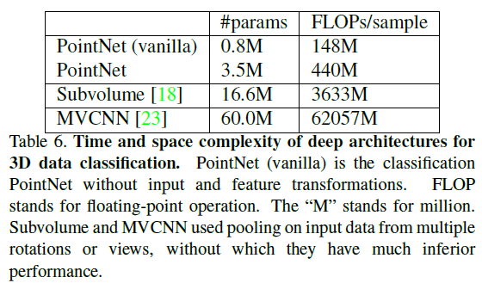
Time and Space Complexity Analysis
Qi, C. R., Su, H., Mo, K., & Guibas, L. J. (2017). Pointnet: Deep learning on point sets for 3d classification and segmentation. In Proceedings of the IEEE conference on computer vision and pattern recognition (pp. 652-660). Cited by 19544
Notes:
But wait, why 3x3? not 4x4? This is a linear transformation:
Includes rotation
scaling
shearing
possibly reflection
But it does not include translation.

Slide 34
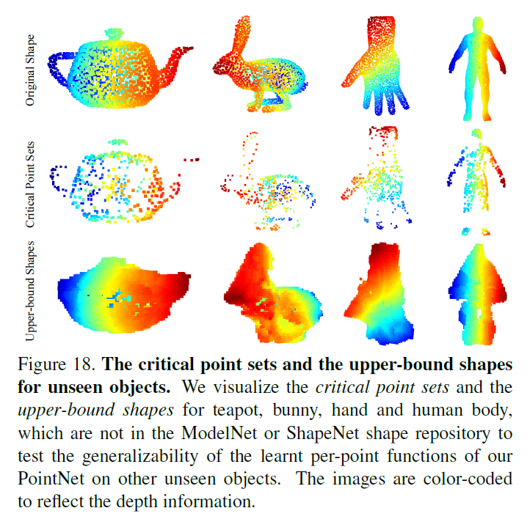
PointNet

Slide 35
More to come
KPConv
DGCNN
PointGPT
…

Slide 36
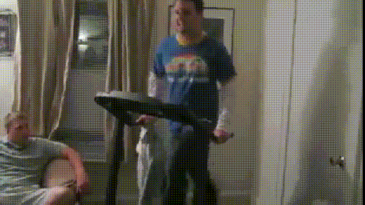
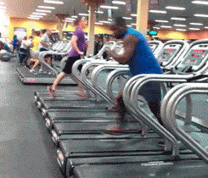
Practical Considerations
Deep learning algorithms are cool …
… until they are out of control.

Slide 37
Practical Considerations
Data Preparation
Garbage in, garbage out: DL models like PointNet are highly sensitive to noisy or inconsistent input data.
Uniform Sampling Needed: PointNet requires fixed-size point sets (e.g., 1,024 points)—need to downsample or pad each point cloud.
Normalization is Critical: Inputs must be centered and scaled to unit spheres—forgetting this leads to unstable training.
Class Imbalance Hurts: Forest scenes with mostly background or ground points can bias models—oversampling or weighted losses may be needed.
Noisy Annotations Break Learning: Manual segmentation errors or weak ground truth can severely hurt generalization.
Training Strategies
Overfitting Is Easy: Especially with small datasets—DL models memorize rather than learn unless regularized.
Data Augmentation Is Essential: Random rotations, jittering, and scaling help simulate variability and improve generalization.
Batch Normalization Matters: PointNet relies on batch norm to stabilize learning; small batch sizes (due to GPU limits) may cause instability.
Custom Loss Functions Often Needed: Cross-entropy alone may not handle spatial smoothness—IoU loss or auxiliary losses can help.

Slide 38

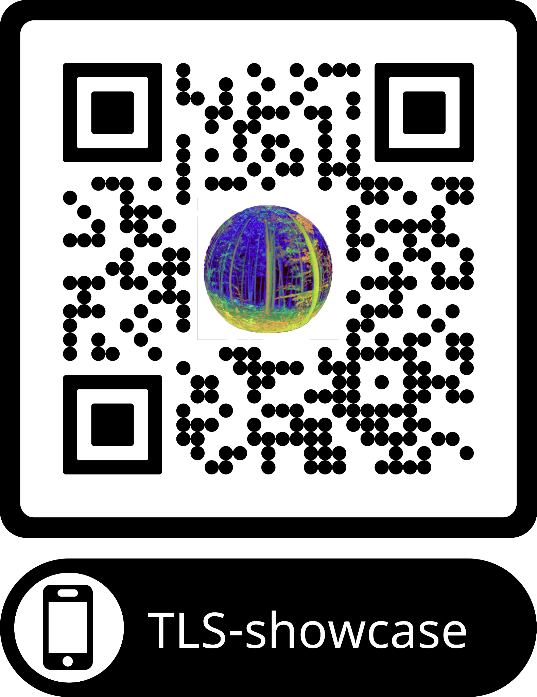
Find the Code, Send me a Message, and More…
https://github.com/fz-rit/LiDAR-session
https://github.com/fz-rit/TLS-showcase

Slide 39
Backup Slides

Slide 40
Feature Extraction & Structural Analysis
PCA & Surface Normals
RANSAC Shape Detection

Slide 41
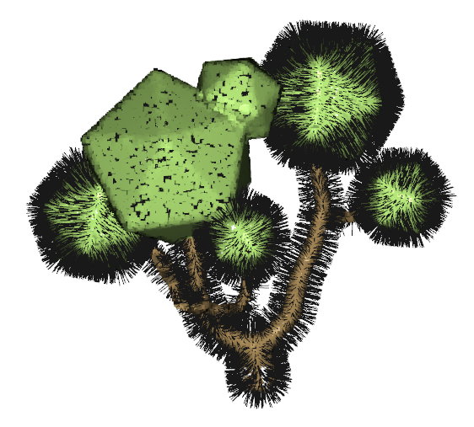
Normals Estimation with PCA
For each point in the point cloud:
Find its k-nearest neighbors (commonly k = 10 ~ 30, depending on point density).
Subtract the centroid of the neighborhood to center the points.
Compute the covariance matrix of the neighbors.
Use eigen decomposition (or SVD) on the covariance matrix.
The eigenvector corresponding to the smallest eigenvalue is the estimated normal direction (it's perpendicular to the best-fit plane).
(Optional) Flip normals to point outward consistently:
This is often done using viewpoint-based orientation or a Minimum Spanning Tree (MST) approach.

Slide 42
RANSAC (RANdom SAmple Consensus)
Randomly selects a small subset of data.
Fits a model to this subset.
Tests how many other data points fit this model within a certain tolerance (called inliers).
Repeats the process a fixed number of times and keeps the model with the most inliers.

Slide 43
RANSAC for Tree Shape Detection
Randomly selects a small subset of data.
Fits a model to this subset.
Tests how many other data points fit this model within a certain tolerance (called inliers).
Repeats the process a fixed number of times and keeps the model with the most inliers.

Slide 44
Classification and Segmentation (non-DL methods)
Voxel based method
Basic idea: Use voxel grids to summarize vertical and horizontal distributions of LiDAR returns, providing ecological insights.
Example method: Vertical voxel profiling:
Vertical distribution of point density/intensity within each horizontal voxel analyzed.
Used to identify canopy layers, forest structure, or biomass estimation.
Typical Applications:
Forest canopy structure assessment.
Biomass estimation and ecological modeling.
Region grow
Region-growing segmentation involves starting from one or more "seed" points and progressively adding neighboring points that satisfy certain similarity criteria (such as geometric similarity, curvature, normal vectors, or intensity). This iterative expansion continues until no more suitable neighboring points can be added.
Notes:
dea:
Start from "seed points" and iteratively expand regions based on local geometric similarity (e.g., normal vectors, curvature, intensity).
Examples:
Tree crown extraction (starting from tree-tops).
Building segmentation (expanding planar surfaces).
Strengths:
Efficient for structured environments, intuitive process.
Limitations:
Sensitive to parameters, may require manual tuning.

Slide 45
Classification and Segmentation (non-DL methods)
Statistical & Machine Learning Approaches (traditional ML, not DL)
Idea:
Traditional ML classifiers like Support Vector Machines (SVM), Random Forests (RF), or Decision Trees using handcrafted geometric features.
Examples:
Point-level classification (e.g., ground, vegetation, urban structures).
Urban or forestry applications using carefully extracted point-features.
Strengths:
Relatively powerful, interpretable, well-established.
Limitations:
Requires extensive feature engineering; performance heavily depends on quality of features.
Notes:
dea:
Start from "seed points" and iteratively expand regions based on local geometric similarity (e.g., normal vectors, curvature, intensity).
Examples:
Tree crown extraction (starting from tree-tops).
Building segmentation (expanding planar surfaces).
Strengths:
Efficient for structured environments, intuitive process.
Limitations:
Sensitive to parameters, may require manual tuning.

Slide 46
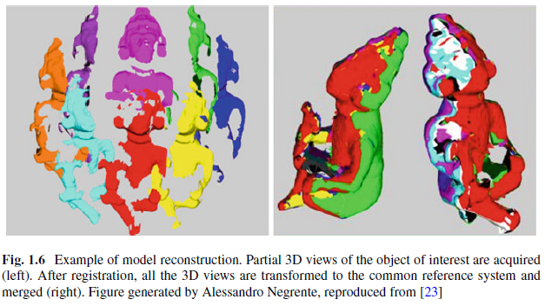
Point Cloud Registration & Alignment

Slide 47
Point Cloud Registration & Alignment
Iterative Closest Point (ICP)

